Slide 1


Tech Instagram Influencer’s account analysis
Unveiling Insights from the World of Tech Influence

Slide 2
We get the data from Instagram activities data
We have three SQL text files for Instagram activity data analysis:
1. dim_dates Contains all dates related to activity data.
2. fact_account Tracks profile visits and new followers.
3. fact_content Includes details on post categories, post types, video duration, impressions, reach, shares, follows, likes, comments, and saves.

Slide 3
We use a set of SQL queries to extract valuable insights from the data by answering key questions.

Slide 4
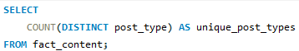
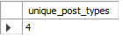
How many distinct types of posts are available?
Query
Solution
There are a total of four types of Instagram posts

Slide 5
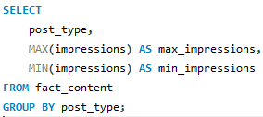
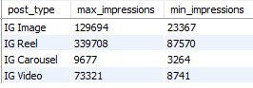
What are the highest and lowest recorded impressions for each post type?
Query
Solution
The highest impressions occur on IG Reels, while the lowest impressions are seen on IG Carousels.

Slide 6
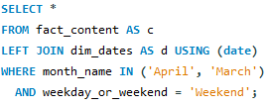
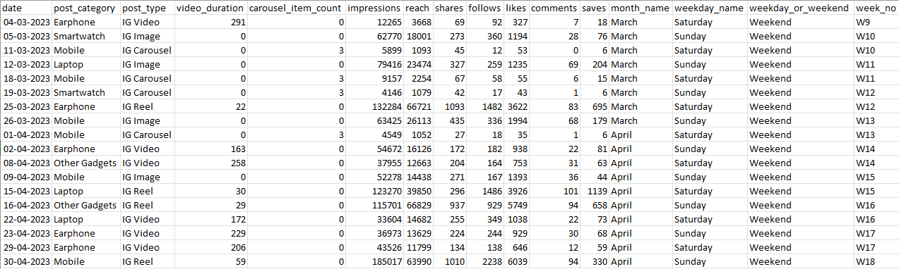
Filter all the posts that were published on a weekend in the month of March and April and export them to a separate csv file.
Query
Solution

Slide 7
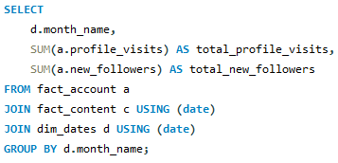
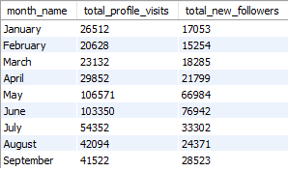
Create a report to get the statistics for the account. The final output includes the following fields: • month_name • total_profile_visits • total_new_followers
Query
Solution
The highest number of profile visits occurred in May, while the highest number of new followers was recorded in June.

Slide 8
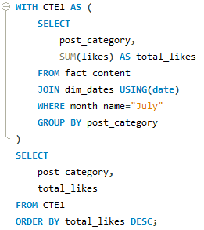
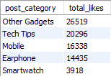
Write a CTE that calculates the total number of 'likes’ for each 'post_category' during the month of 'July' and subsequently, arrange the 'post_category' values in descending order according to their total likes.
Query
Solution
The "Other Gadgets" post category received the highest number of likes.

Slide 9
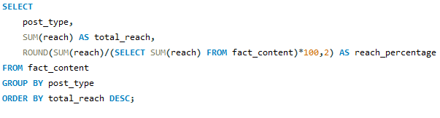
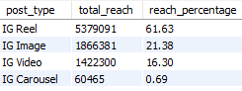
What is the percentage breakdown of total reach by post type? The final output includes the following fields: • post_type • total_reach • reach_percentage
Query
Solution
The total reach for the IG Reel post type is the highest, accounting for 61.63%.

Slide 10
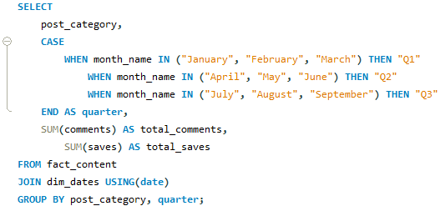
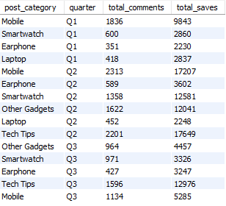
Create a report that includes the quarter, total comments, and total saves recorded for each post category. The final output columns should consist of: • post_category • quarter • total_comments • total_saves
Query
Solution

Slide 11
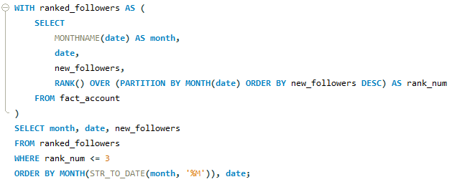
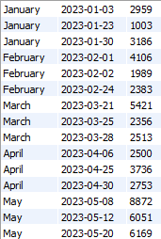
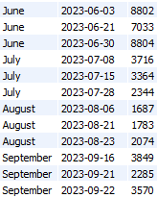
List the top three dates in each month with the highest number of new followers. The final output should include the following columns: • month • date • new_followers
Query
Solution

Slide 12
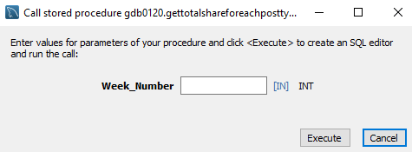
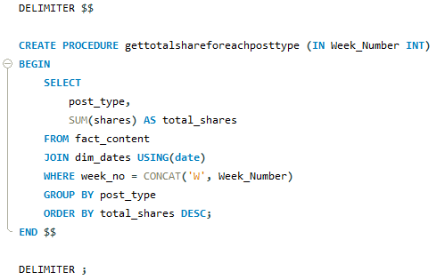
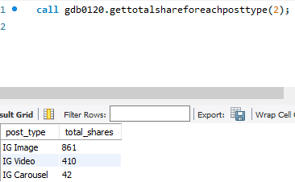
Create a stored procedure that takes the 'Week_no' as input and generates a report displaying the total shares for each 'Post_type'. The output of the procedure should consist of two columns: • post_type • total_shares
Query
Solution

Slide 13
Thank You!

